Slide 1
关山复度路犹长
2025.1 数据库

Slide 2
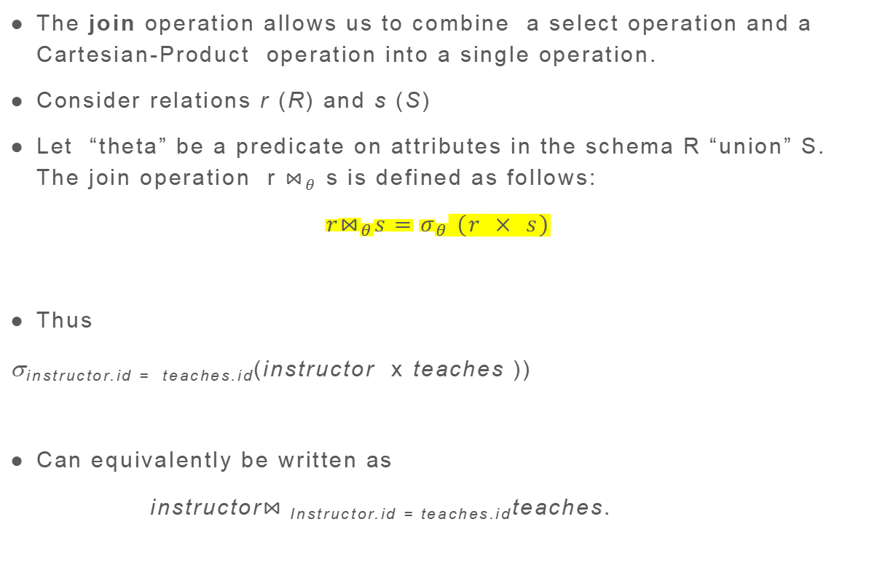
Join Operation (Cont.)
The join operation allows us to combine a select operation and a Cartesian-Product operation into a single operation.
Consider relations r (R) and s (S)
Let “theta” be a predicate on attributes in the schema R “union” S. The join operation r $⋈_{θ}$ s is defined as follows:
$$r⋈_{θ}s=σ_{θ} (r × s)$$
Thus
σ_{instructor.id = teaches.id}(instructor x teaches ))
Can equivalently be written as
instructor$⋈_{ }$_{Instructor.id = teaches.id}teaches.

Slide 3
Union Operation
The union operation allows us to combine two relations
Notation: r ∪ s
For r ∪ s to be valid.
1. r, s must have the same arity (same number of attributes)
2. The attribute domains must be compatible (example: 2nd
column of r deals with the same type of values as does the
2nd column of s)
R和S要有相同数量的属性，且相同位置上的属性要可以计算
（比如都是数字，而不能是数字和文字）
Example: to find all courses taught in the Fall 2017 semester, or in the Spring 2018 semester, or in both ∏_{course_id} (σ _{semester=“Fall” Λ year=2017} (section)) ∪ ∏_{course_id} (σ _{semester=“Spring” Λ year=2018} (section))

Slide 4

Set Difference Operation
The set-difference operation allows us to find tuples that are in one relation but are not in another.
Notation r – s
Set differences must be taken between compatible relations.
r and s must have the same arity
attribute domains of r and s must be compatible
Example: to find all courses taught in the Fall 2017 semester, but not in the Spring 2018 semester ∏_{course_id} (σ _{semester=“Fall” Λ year=2017} (section)) − ∏_{course_id} (σ _{semester=“Spring” Λ year=2018} (section))

Slide 5
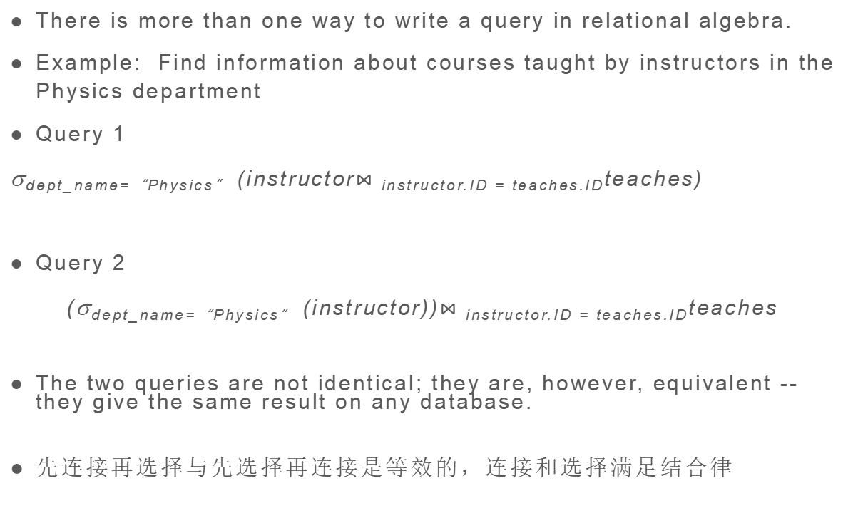
Equivalent Queries
There is more than one way to write a query in relational algebra.
Example: Find information about courses taught by instructors in the Physics department
Query 1
σ_{dept_name=“Physics”} (instructor$⋈_{ }$_{instructor.ID = teaches.ID}teaches)
Query 2
(σ_{dept_name=“Physics”} (instructor))$⋈_{ }$_{instructor.ID = teaches.ID}teaches
The two queries are not identical; they are, however, equivalent -- they give the same result on any database.
先连接再选择与先选择再连接是等效的，连接和选择满足结合律

Slide 6
Dangerous in Natural Join
Beware of unrelated attributes with same name which get equated incorrectly 危险：同名异义
在三个关系模式连续自然连接时需要注意可能出现错误
Example -- List the names of students instructors along with the titles of courses that they have taken
Correct version
select name, title from student natural join takes, course where takes.course_id = course.course_id;
Incorrect version
select name, title from student natural join takes natural join course;
This query omits all (student name, course title) pairs where the student takes a course in a department other than the student's own department.
The correct version (above), correctly outputs such pairs.

Slide 7
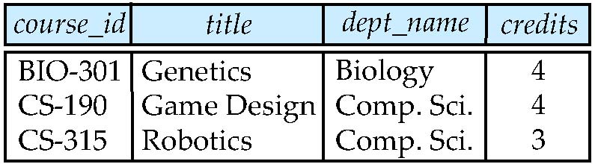
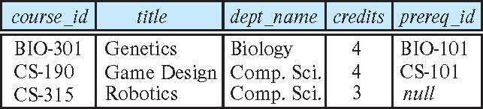
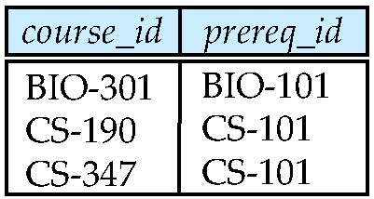
Outer Join
An extension of the join operation that avoids loss of information.
外连接保留失配元组。意思就是在自然连接中，只有左右两边在指定值上相等的元组才会被保留，而在外连接中，未被匹配的元组也会被保留。
Computes the join and then adds tuples form one relation that does not match tuples in the other relation to the result of the join.
Uses null values.
Three forms of outer join:
left outer join 左外连接——位于左边的关系中会保留失配元组
right outer join 右外连接——位于右边的关系中会保留
full outer join 全外连接——两边都会保留
course ⟕ prereq

Slide 8
View Definition（与with查询类似）
A view is defined using the create view statement which has the form
create view v as < query expression >
where <query expression> is any legal SQL expression. The view name is represented by v.
Once a view is defined, the view name can be used to refer to the virtual relation that the view generates. 虚表
View definition is not the same as creating a new relation by evaluating the query expression
Rather, a view definition causes the saving of an expression; the expression is substituted into queries using the view.
视图是使用 create view 语句定义的，该语句的格式为
create view v as < query expression >
其中<query expression> 是任何合法的 SQL 表达式。 视图名称由 v 表示。
定义视图后，视图名称可用于引用视图生成的虚拟关系。虚表
视图定义与通过计算查询表达式来创建新关系不同
相反，视图定义会导致保存表达式;表达式将使用 View 替换到查询中。

Slide 9
Materialized Views
Certain database systems allow view relations to be physically stored.
Physical copy created when the view is defined.
Such views are called Materialized view: 物化视图，数据要存
If relations used in the query are updated, the materialized view result becomes out of date
Need to maintain the view, by updating the view whenever the underlying relations are updated.

Slide 10
Referential Integrity
Ensures that a value that appears in one relation for a given set of attributes also appears for a certain set of attributes in another relation.
Example: If “Biology” is a department name appearing in one of the tuples in the instructor relation, then there exists a tuple in the department relation for “Biology”.
Let A be a set of attributes. Let R and S be two relations that contain attributes A and where A is the primary key of S. A is said to be a foreign key of R if for any values of A appearing in R these values also appear in S. 外码
确保在给定属性集的一个关系中出现的值也出现在另一个关系中的特定属性集上。
示例：如果 “Biology” 是出现在讲师关系的某个元组中的部门名称，则 “Biology” 的部门关系中存在一个元组。
设 A 为一组属性。 设 R 和 S 是包含属性 A 的两个关系，其中 A 是 S 的主键。如果 A 的任何值出现在 R 中，这些值也出现在 S 中，则称 A 是 R 的外键/外码。

Slide 11
Complex Check Conditions
The predicate in the check clause can be an arbitrary predicate that can include a subquery.
check (time_slot_id in (select time_slot_id from time_slot))
The check condition states that the time_slot_id in each tuple in the section relation is actually the identifier of a time slot in the time_slot relation.
The condition has to be checked not only when a tuple is inserted or modified in section , but also when the relation time_slot changes
Cannot use subquery in check constraint. 注意，几乎所有的DBMS不支持带子查询的check约束
不仅在 section 中插入或修改 tuples 时必须检查条件，而且当关系time_slot发生变化时也必须检查该条件
不能在 check 约束中使用 subquery。 注意，几乎所有的DBMS不支持带子查询的check约束

Slide 12
Division Operator
Given relations r(R) and s(S), such that S ⊂ R, r ÷ s is the largest relation t(R-S) such that 商是满足逆乘不溢出的最大关系
除法是左侧的值中 在右侧中全部有对应的 值才会被保留，往往用于查询“所有” t x s ⊆ r
E.g. let r(ID, course_id) = ∏_{ID, course_id} (takes ) and s(course_id) = ∏_{course_id} (σ_{dept_name=“Biology”}(course ) then r ÷ s gives us students who have taken all courses in the Biology department
Can write r ÷ s as
temp1 ← ∏_{R-S} (r ) temp2 ← ∏_{R-S} ((temp1 x s ) – ∏_{R-S,S} (r )) result = temp1 – temp2
The result to the right of the ← is assigned to the relation variable on the left of the ←.
May use variable in subsequent expressions.

Slide 13
Many-to-One Relationships
In a many-to-one relationship between an instructor and a student,
an instructor is associated with at most one student via advisor,
and a student is associated with several (including 0) instructors via advisor
一对多，多对一，多对多，一对一
的箭头不一样，“多”的那方没有箭头，“一”的那方有箭头（真有说法吗）

Slide 14
Primary Key for Relationship Sets
To distinguish among the various relationships of a relationship set we use the individual primary keys of the entities in the relationship set.
Let R be a relationship set involving entity sets E1, E2, .. En
The super key for R is consists of the union of the primary keys of entity sets E1, E2, ..En
NOTE: this means a pair of entity sets can have at most one relationship in a particular binary relationship set. 对于二元联系，实体集间任一对实体最多产生一个联系
If the relationship set R has attributes a1, a2, .., am associated with it, then the super key of R also includes the attributes a1, a2, .., am
Example: relationship set “advisor”.
The primary key consists of instructor.ID and student.ID
The choice of the primary key for a relationship set depends on the mapping cardinality of the relationship set.

Slide 15
Functional Dependencies Definition
Let R be a relation schema
α ⊆ R and β ⊆ R
The functional dependency
α → β
holds on R if and only if for any legal relations r(R), whenever any two tuples t₁ and t₂ of r agree on the attributes α, they also agree on the attributes β. That is,
t₁[α] = t₂ [α] ⇒ t₁[β ] = t₂ [β ]
Example: Consider r(A,B ) with the following instance of r.
On this instance, B → A hold; A → B does NOT hold,
4
1 5
3 7

Slide 16
Boyce-Codd Normal Form BC范式
A relation schema R is in BCNF with respect to a set F of functional dependencies if for all functional dependencies in F⁺ of the form
α → β
where α ⊆ R and β ⊆ R, at least one of the following holds:
α → β is trivial (i.e., β ⊆ α)
α is a superkey for R
It is not always possible to achieve both BCNF and dependency preservation
分解到BC范式不能保证总能保持函数依赖

Slide 17
Third Normal Form 3范式
A relation schema R is in third normal form (3NF) if for all:
α → β in F⁺
at least one of the following holds:
α → β is trivial (i.e., β ∈ α)
α is a superkey for R
Each attribute A in β – α is contained in a candidate key for R.比BC范式多了一个条件
(NOTE: each attribute may be in a different candidate key)
If a relation is in BCNF it is in 3NF (since in BCNF one of the first two conditions above must hold).
Third condition is a minimal relaxation of BCNF to ensure dependency preservation (will see why later). 放松的第三个条件用以保证保持函数依赖

Slide 18
Second Normal Form 2范式
A functional dependency α → β is called a partial dependency if there is a proper subset γ of α such that γ → β . We say that β is partially dependent on α.
A relation schema R is in second normal form (2NF) if each attribute A in R meets one of the following:
It appears in a Candidate key.
It is not partially dependent on a candidate key.
(条件比3NF条件宽)
如果 R 中的每个属性 A 都满足以下条件之一，则关系架构 R
符合第二范式 （2NF）：
它在 Candidate 键中。
它不部分依赖于候选键。
Example
R = (A, B, C)
F ={ A → B, B → C}
满足2NF， 不满足3NF

Slide 19
Closure of a Set of Functional Dependencies
Given a set F set of functional dependencies, there are certain other functional dependencies that are logically implied by F.
If A → B and B → C, then we can infer that A → C
etc.
The set of all functional dependencies logically implied by F is the closure of F. 函数依赖集闭包
We denote the closure of F by F⁺.

Slide 20
Closure of a Set of Functional Dependencies
We can compute F⁺, the closure of F, by repeatedly applying Armstrong’s Axioms:阿姆斯特朗公理系统
Reflexive rule: if β ⊆ α, then α → β 自反律
Augmentation rule: if α → β, then γ α → γ β 增广律
Transitivity rule: if α → β, and β → γ, then α → γ 传递律
These rules are
Sound -- generate only functional dependencies that actually hold, and 正确的（推出来的都正确）
Complete -- generate all functional dependencies that hold. 完备的（蕴含的都推得出来）

Slide 21
Closure of Functional Dependencies (Cont.)
Additional rules:
Union rule: If α → β holds and α → γ holds, then α → β γ holds.合并规则
Decomposition rule: If α → β γ holds, then α → β holds and α → γ holds. 分解规则
Pseudotransitivity rule:If α → β holds and γ β → δ holds, then α γ → δ holds. 伪传递规则
The above rules can be inferred from Armstrong’s axioms.

Slide 22
Canonical Cover正则覆盖
A canonical cover for F is a set of dependencies F_{c} such that
F logically implies all dependencies in F_{c} , and
F_{c} logically implies all dependencies in F, and
No functional dependency in F_{c} contains an extraneous attribute, and
Each left side of functional dependency in F_{c} is unique. That is, there are no two dependencies in F_{c}
α₁ → β₁ and α₂ → β₂ such that
α₁ = α₂
正则覆盖（Canonical Cover）是指一组函数依赖的最小集合，它保持了原始函数依赖集的功能，并且满足以下两个条件：
没有冗余的函数依赖：对于每一个函数依赖 X → Y，在正则覆盖中都不能进一步简化为更小的左部或右部而不改变其语义。即不存在X的一个真子集X'使得X' → Y成立；同时Y也不能被减少到一个更小的集合而保持相同的语义。
没有冗余的属性：对于每个函数依赖 X → Y 中的每个属性 A ∈ X 和 B ∈ Y，A 不是冗余的。也就是说，如果从 X 或 Y 中移除任何单个属性，则该函数依赖将不再成立。

Slide 23
Canonical Cover
To compute a canonical cover for F:
repeat
Use the union rule to replace any dependencies in F of the form
α₁ → β₁ and α₁ → β₂ with α₁ → β₁ β₂
Find a functional dependency α → β in F_{c} with an extraneous
attribute either in α or in β
/* Note: test for extraneous attributes done using F_{c,} not F*/
If an extraneous attribute is found, delete it from α → β
until (F_{c} not change
Note: Union rule may become applicable after some extraneous attributes have been deleted, so it has to be re-applied
构建正则覆盖的方法通常包括以下步骤：
消除冗余的函数依赖：检查并移除那些可以从其他函数依赖推导出来的函数依赖。
替换左边的属性集：对于每个函数依赖，尝试去除左部中的任何不必要的属性。
替换右边的属性：确保右部的每个属性都是必需的，不能被其他属性所替代或合并。

Slide 24
Example of BCNF Decomposition
class (course_id, title, dept_name, credits, sec_id, semester, year, building, room_number, capacity, time_slot_id)
Functional dependencies:
course_id→ title, dept_name, credits
building, room_number→capacity
course_id, sec_id, semester, year→building, room_number, time_slot_id
A candidate key {course_id, sec_id, semester, year}.
BCNF Decomposition:
course_id→ title, dept_name, credits holds
but course_id is not a superkey.
We replace class by:
course(course_id, title, dept_name, credits)
class-1 (course_id, sec_id, semester, year, building, room_number, capacity, time_slot_id)

Slide 25
3NF Decompsition Example (Cont.)
The for loop generates following 3NF schema:
(customer_id, employee_id, type )
(employee_id, branch_name)
(customer_id, branch_name, employee_id)
Observe that (customer_id, employee_id, type ) contains a candidate key of the original schema, so no further relation schema needs be added
At end of for loop, detect and delete schemas, such as (employee_id, branch_name), which are subsets of other schemas
result will not depend on the order in which FDs are considered
The resultant simplified 3NF schema is:
(customer_id, employee_id, type)
(customer_id, branch_name, employee_id)

Slide 26
Comparison of BCNF and 3NF
It is always possible to decompose a relation into a set of relations that are in 3NF such that: 分解到3NF
The decomposition is lossless 无损
The dependencies are preserved 保持函数依赖
It is always possible to decompose a relation into a set of relations that are in BCNF such that: 分解到BC范式
The decomposition is lossless 无损
It may not be possible to preserve dependencies.可能不保持函数依赖

Slide 27
Fourth Normal Form
A relation schema R is in 4NF with respect to a set D of functional and multivalued dependencies if for all multivalued dependencies in D⁺ of the form α →→ β, where α ⊆ R and β ⊆ R, at least one of the following hold:
α →→ β is trivial (i.e., β ⊆ α or α ∪ β = R)
α is a superkey for schema R
If a relation is in 4NF it is in BCNF

Slide 28
First Normal Form
Domain is atomic if its elements are considered to be indivisible units
Examples of non-atomic domains:
Set of names, composite attributes
Identification numbers like CS101 that can be broken up into parts
A relational schema R is in first normal form if the domains of all attributes of R are atomic
Non-atomic values complicate storage and encourage redundant (repeated) storage of data
Example: Set of accounts stored with each customer, and set of owners stored with each account
We assume all relations are in first normal form (and revisit this in Chapter 22: Object Based Databases)

Slide 29
分别解释什么是第一，第二，第三，第四范式
第一范式 (1NF, First Normal Form)
原子性：每个字段（列）的值必须是不可分割的基本数据项，即每个单元格只包含单个值。
唯一行：表中没有重复的行（记录），每一行都应该是唯一的，可以通过主键或候选键来唯一标识。
固定结构：每张表都有固定的列数，且这些列在整个表的所有行中保持一致。
遵循第一范式的目的是确保表中的每一个单元格都是单一值，并且每一行的数据都是独一无二的。
第二范式 (2NF, Second Normal Form)
一个关系模式要符合第二范式，它首先必须满足第一范式的要求。
此外，所有非主属性（非主键字段）必须完全依赖于整个主键，而不是部分依赖。也就是说，如果一个表有一个复合主键，则每个非主属性不能仅依赖于主键的一部分。
通过遵守第二范式，可以消除部分依赖，从而进一步减少数据冗余。

Slide 30
分别解释什么是第一，第二，第三，第四范式
第三范式 (3NF, Third Normal Form)
一个关系模式要符合第三范式，它首先必须满足第二范式的要求。
在此基础上，所有非主属性之间不存在传递依赖。换句话说，非主属性只能依赖于主键，而非其他非主属性。
第三范式的目的是消除非主属性之间的依赖，从而避免更新异常、插入异常和删除异常。
第四范式 (4NF, Fourth Normal Form)
一个关系模式要符合第四范式，它首先必须满足第三范式的要求。
此外，对于多值依赖，除了平凡的多值依赖（即每个属性对自身或多值依赖的右侧包含主键）之外，不允许存在非平凡的多值依赖。
第四范式主要关注的是处理多值依赖的问题，确保一个多值属性不会导致不必要的数据冗余。
总结
随着范式的提升，我们逐步解决了不同类型的依赖问题：
1NF 消除重复组。2NF 消除部分依赖。3NF 消除传递依赖。4NF 消除多值依赖。

Slide 31
Equivalence Rules
1. Conjunctive selection operations can be deconstructed into a sequence of individual selections. σ_{θ1 ∧ θ2} (E) ≡ σ_{θ1} (σ_{θ2} (E))
2. Selection operations are commutative. σ_{θ1}(σ_{θ2}(E)) ≡ σ_{θ2} (σ_{θ1}(E))
3. Only the last in a sequence of projection operations is needed, the others can be omitted. ∏ _{L1}(∏ _{L2}(…(∏ _{Ln}(E))…)) ≡ ∏ _{L1}(E) where L₁ ⊆ L₂ … ⊆ L_{n}
4. Selections can be combined with Cartesian products and theta joins.
σ_{θ} (E₁ x E₂) ≡ E₁ ⨝ _{θ} E₂
σ _{θ1} (E₁ ⨝_{θ2} E₂) ≡ E₁ ⨝ _{θ1∧θ2} E₂

Slide 32
Equivalence Rules (Cont.)
5. Theta-join operations (and natural joins) are commutative. E₁ ⨝ E₂ ≡ E₂ ⨝ E₁
6. (a) Natural join operations are associative:
(E₁ ⨝ E₂) ⨝ E₃ ≡ E₁ ⨝ (E₂ ⨝ E₃) (b) Theta joins are associative in the following manner: (E₁ ⨝ _{θ1} E₂) ⨝ _{θ2 ∧ θ3} E₃ ≡ E₁ ⨝_{θ1 ∧ θ3} (E₂ ⨝ _{θ2} E₃) where θ₂ involves attributes from only E₂ and E₃.

Slide 33
Equivalence Rules (Cont.)
7. The selection operation distributes over the theta join operation under the following two conditions: (a) When all the attributes in θ₀ involve only the attributes of one of the expressions (E₁) being joined. σ_{θ0} (E₁ ⨝_{θ} E₂) ≡ (σ_{θ0}(E₁)) ⨝_{θ} E₂
(b) When θ₁ involves only the attributes of E₁ and θ₂ involves only the attributes of E₂.
σ_{θ1 ∧ θ2} (E₁ ⨝_{θ} E₂) ≡ (σ_{θ1}(E₁)) ⨝_{θ} (σ_{θ2}(E₂))

Slide 34
Equivalence Rules (Cont.)
8. The projection operation distributes over the theta join operation as follows:
(a) if θ involves only attributes from L₁ ∪ L₂: ∏ _{L1 ∪ L2}(E₁ ⨝_{θ} E₂) ≡ ∏ _{L1}(E₁) ⨝_{θ} ∏ _{L2}(E₂)
(b) In general, consider a join E₁ ⨝_{θ} E₂.
Let L₁ and L₂ be sets of attributes from E₁ and E₂, respectively.
Let L₃ be attributes of E₁ that are involved in join condition θ, but are not in L₁ ∪ L₂, and
let L₄ be attributes of E₂ that are involved in join condition θ, but are not in L₁ ∪ L₂. ∏ _{L1 ∪ L2}(E₁ ⨝_{θ} E₂) ≡ ∏ _{L1 ∪ L2}(∏ _{L1 ∪ L3}(E₁) ⨝_{θ} ∏ _{L2 ∪ L4}(E₂))
Similar equivalences hold for outerjoin operations: ⟕, ⟖, and ⟗

Slide 35
Equivalence Rules (Cont.)
9. The set operations union and intersection are commutative E₁∪ E₂ ≡ E₂∪ E₁ E₁∩ E₂ ≡ E₂∩ E₁ (set difference is not commutative).
10. Set union and intersection are associative. (E₁∪ E₂ ) ∪ E₃ ≡E₁∪ (E₂ ∪ E₃) (E₁∩ E₂ ) ∩ E₃ ≡ E₁∩ (E₂ ∩ E₃)
11. The selection operation distributes over ∪, ∩ and –. a. σ_{θ}(E₁∪E₂) ≡ σ_{θ}(E₁) ∪σ_{θ}(E₂) b. σ_{θ}(E₁∩E₂) ≡σ_{θ}(E₁) ∩σ_{θ}(E₂) c. σ_{θ}(E₁ – E₂) ≡ σ_{θ}(E₁) – σ_{θ}(E₂) d. σ_{θ}(E₁∩E₂) ≡σ_{θ}(E₁) ∩E₂ e. σ_{θ}(E₁ – E₂) ≡σ_{θ}(E₁) – E₂ preceding equivalence does not hold for ∪
12. The projection operation distributes over union Π_{L}(E₁∪ E₂) ≡ (Π_{L}(E₁)) ∪ (Π_{L}(E₂))

Slide 36
Equivalence Rules (Cont.)
13. Selection distributes over aggregation as below σ_{θ}(_{G}𝛾_{A}(E)) ≡ _{G}𝛾_{A}(σ_{θ}(E)) provided θ only involves attributes in G
14. a. Full outerjoin is commutative: E₁ ⟗ E₂ ≡ E₂ ⟗ E₁ b. Left and right outerjoin are not commutative, but: E₁ ⟕ E₂ ≡ E₂ ⟖ E₁
15. Selection distributes over left and right outerjoins as below, provided θ₁
only involves attributes of E₁ a. σ_{θ1} (E₁ ⟕_{θ} E₂) ≡ (σ_{θ1} (E₁)) ⟕_{θ} E₂ b. σ_{θ1} (E₁ ⟖_{θ} E₂) ≡ E₂ ⟕_{θ} (σ_{θ1} (E₁))
16. Outerjoins can be replaced by inner joins under some conditions
a. σ_{θ1} (E₁ ⟕_{θ} E₂) ≡ σ_{θ1} (E₁ ⨝_{θ} E₂) b. σ_{θ1} (E₁ ⟖_{θ} E₁) ≡ σ_{θ1} (E₁ ⨝_{θ} E₂) provided θ₁ is null rejecting on E₂

Slide 37
Equivalence Rules (Cont.)
Note that several equivalences that hold for joins do not hold for outerjoins
自然连接满足交换律与结合律，但三种外连接都不满足结合律
全外连接满足交换律，左右外连接不满足交换律
σ_{year=2017}(instructor ⟕ teaches) ≢ σ_{year=2017}(instructor ⨝ teaches)
Outerjoins are not associative (r ⟕ s) ⟕ t ≢ r ⟕ (s ⟕ t)
e.g. with r(A,B) = {(1,1), s(B,C) = { (1,1)}, t(A,C) = { }
Notes:
How about (r ⟕ s) ⟕ t vs (r ⟕ t) ⟕ s assuming r has common attributes with s and t? Hint: consider 2 cases where s and t have common attributes and those where they have no common attribute

Slide 38
Heuristic（启发式） Optimization
Cost-based optimization is expensive, even with dynamic programming.
Systems may use heuristics to reduce the number of choices that must be made in a cost-based fashion.
Heuristic optimization transforms the query-tree by using a set of rules that typically (but not in all cases) improve execution performance:
Perform selection early (reduces the number of tuples)
Perform projection early (reduces the number of attributes)
Perform most restrictive selection and join operations (i.e., with smallest result size) before other similar operations.
Some systems use only heuristics, others combine heuristics with partial cost-based optimization.
基于成本的优化成本高昂，即使使用动态规划也是如此。
系统可以使用启发式方法来减少必须以基于成本的方式做出的选择数量。
启发式优化通过使用一组规则来转换查询树，
这些规则通常（但并非在所有情况下）可以提高执行性能：
尽早执行选择（减少 Tuples 的数量）
提前执行投影（减少属性数量）
在其他类似操作之前执行限制性最强的选择和连接操作（即，具有最小的结果大小）。
一些系统仅使用启发式方法，而其他系统将启发式方法与基于部分成本的优化相结合。

Slide 39
ACID Properties
A transaction is a unit of program execution that accesses and possibly updates various data items. To preserve the integrity of data the database system must ensure:
Atomicity. Either all operations of the transaction are properly reflected in the database or none are. 原
Consistency. Execution of a transaction in isolation preserves the consistency of the database. 致
Isolation. Although multiple transactions may execute concurrently, each transaction must be unaware of other concurrently executing transactions. Intermediate transaction results must be hidden from other concurrently executed transactions. 隔
That is, for every pair of transactions T_{i} and T_{j}, it appears to T_{i} that either T_{j}, finished execution before T_{i} started, or T_{j} started execution after T_{i} finished.
Durability. After a transaction completes successfully, the changes it has made to the database persist, even if there are system failures. 久

Slide 40
View Serializability
Let S and S’ be two schedules with the same set of transactions. S and S’ are view equivalent if the following three conditions are met, for each data item Q, 视图等价
1. If in schedule S, transaction T_{i} reads the initial value of Q, then in
schedule S’ also transaction T_{i} must read the initial value of Q.
2. If in schedule S transaction T_{i} executes read(Q), and that value was produced by transaction T_{j} (if any), then in schedule S’ also
transaction T_{i} must read the value of Q that was produced by the
same write(Q) operation of transaction T_{j} .
3. The transaction (if any) that performs the final write(Q) operation in
schedule S must also perform the final write(Q) operation in schedule S’.
As can be seen, view equivalence is also based purely on reads and writes alone.

Slide 41
Lock-Based Protocols
A lock is a mechanism to control concurrent access to a data item
Data items can be locked in two modes :
1. exclusive (X) mode. Data item can be both read as well as
written. X-lock is requested using lock-X instruction. 独占锁（排它锁）
2. shared (S) mode. Data item can only be read. S-lock is
requested using lock-S instruction. 共享锁
Lock requests are made to concurrency-control manager. Transaction can proceed only after request is granted.

Slide 42
The Two-Phase Locking Protocol
A protocol which ensures conflict-serializable schedules.
Phase 1: Growing Phase
Transaction may obtain locks
Transaction may not release locks
Phase 2: Shrinking Phase
Transaction may release locks
Transaction may not obtain locks
The protocol assures serializability. It can be proved that the transactions can be serialized in the order of their lock points (i.e., the point where a transaction acquired its final lock). 封锁点
Locks
Time

Slide 43
Lock Conversions
Two-phase locking protocol with lock conversions:
– Growing Phase:
can acquire a lock-S on item
can acquire a lock-X on item
can convert a lock-S to a lock-X (upgrade)
– Shrinking Phase:
can release a lock-S
can release a lock-X
can convert a lock-X to a lock-S (downgrade)
This protocol ensures serializability

Slide 44
Intention Lock Modes意向锁模式
In addition to S and X lock modes, there are three additional lock modes with multiple granularity:
intention-shared (IS): indicates explicit locking at a lower level of the tree but only with shared locks.
intention-exclusive (IX): indicates explicit locking at a lower level with exclusive or shared locks
shared and intention-exclusive (SIX): the subtree rooted by that node is locked explicitly in shared mode and explicit locking is being done at a lower level with exclusive-mode locks.
Intention locks allow a higher level node to be locked in S or X mode without having to check all descendent nodes.

Slide 45
Compatibility Matrix with Intention Lock Modes
The compatibility matrix for all lock modes is:

Slide 46
Timestamp-Ordering Protocol
The timestamp ordering (TSO) protocol 时间戳顺序协议
Maintains for each data Q two timestamp values:
W-timestamp(Q) is the largest time-stamp of any transaction that executed write(Q) successfully.
R-timestamp(Q) is the largest time-stamp of any transaction that executed read(Q) successfully.
Imposes rules on read and write operations to ensure that
Any conflicting operations are executed in timestamp order
Out of order operations cause transaction rollback

Slide 47

数据库恢复机制对应关系
问题类型 | 出现频率 | 对事务的影响 | 解决方法
无故障下事务回滚 | 高 | 原子性 | 单机数据库恢复
事务故障 | 较高 | 原子性
系统崩溃能重启 | 中等 | 原子性/持久性
磁盘故障 | 低 | 持久性 | 数据多副本
系统崩溃不能重启 | 低 | 持久性 | 一主多备
自然灾害 | 极低 | 持久性 | 异地多机恢复
Durability→ High Availability
磁盘→多机高可用
数据库系统—故障恢复 ₁₁

Slide 48
口有关数据库日志的三个重要性质：
一幂等性： 一条日志记录无论执行一次或多次，得到的结果都是一致的。
· 例 如 ：x=x+1 不 幂 等 ；x=0 幂等
· 物理日志满足幂等性；逻辑日志不满足
-失败可重做性： 一条日志执行失败后，是否可以重做一遍达成恢复目的。
·例如：插入一条记录失败，再次插入成功。
·物理日志满足失败可重做性；逻辑日志不满足：例如插入数据页面成功，而插入索引失败， 重做插入这个逻辑日志失败。
-操作可逆性：逆向执行日志记录的操作，可以恢复原来状态(未执行这批操作时的状态) · 例如第10个页面第100偏移量的值由20改成21,逆操作由21改成20
· 物理日志不可逆(页面偏移量位置可能被后续记录修改),逻辑日志可逆。
数据库系统—故障恢复 ₃₄

Slide 49
日志性质比较及使用场景
 | 解析速度 | 日志量 | 可重做性 | 幂等性 | 可逆性 | 应用场景
物理日志 | 快 | 大 | 是 | 是 | 否 | 重做日志
逻辑日志 物理逻辑日志 | 慢 较快 | 小 中 | 否 是 | 否 否 | 是 否 | 撤销日志 撤销日志
注：物理逻辑日志用于回滚时，特别是索引页面分裂，可通过页 面前后指针来完成回滚。
37
√ 逻辑日志不具有幂等性
√逻辑日志不具有失败可重做性
· 一条逻辑日志记录可能对应多项数据修改(表、索引),崩溃时X对索引造成影响，但没有影响数据页面。
√ 是否能用逻辑日志重做日志记录?
· 重做/不重做都有问题!
√ 因 此redo 日志须用物理日志
√物理日志不具有可逆性，无法处理数据项位置变化的情况页面分裂后A的地址发生了变化，撤销的时候无法定位数据项
√ 因此物理日志一般不能用于回滚，Undo日志须用逻辑日志

Slide 50

ARIES 算法优化总结
问题 | 优化对策
重做阶段不必要的数据页面更新 | 引入脏页表，更新前通过比较检查，优化更 新效率
撤销阶段不必要的日志扫描 | 引入活跃事务表和prevLSN,跳过不相关的 日志记录
撤销阶段的故障恢复 | 引入补偿日志和undoNextLSN字段，确保 撤销只执行一次
日志太多导致恢复时间过长 | 引入模糊检查点和增量检查点，优化了恢复 速度
数据库系统—故障恢复 92

Slide 51
1. 读未提交（Read Uncommitted）
特性：这是最低的隔离级别，允许一个事务读取另一个事务尚未提交的数据（脏读）。这可能导致读取到不一致的数据。
问题：
脏读（Dirty Reads）：可以读取到其他事务尚未提交的数据。
优点：提供了最高的并发度，因为几乎没有任何锁机制阻止读操作。
缺点：由于缺乏隔离性，可能会导致数据不一致性。
2. 读已提交（Read Committed）
特性：一个事务只能读取已经提交的数据。这意味着一个事务不能读取其他事务尚未提交的数据，从而避免了脏读。
问题：
不可重复读（Non-repeatable Reads）：如果同一行数据在两次读取之间被其他事务修改并提交，那么两次读取的结果可能不同。
幻读（Phantom Reads）：如果在两次查询之间插入或删除了新的行，那么第二次查询可能会返回不同的结果集。
优点：防止了脏读，提高了数据的一致性。
缺点：仍然可能出现不可重复读和幻读的问题。

Slide 52
3. 可重复读（Repeatable Read）
特性：在一个事务中，对于同一行数据的多次读取将返回相同的结果，即使这些行在两次读取之间被其他事务修改并提交。它防止了不可重复读。
问题：
幻读（Phantom Reads）：尽管同一行数据的读取结果是固定的，但如果在两次查询之间插入或删除了新的行，那么第二次查询可能会返回不同的结果集。
优点：除了防止脏读外，还解决了不可重复读的问题。
缺点：依然可能发生幻读，并且通常需要更多的锁定来保证一致性，这可能降低并发性能。
4. 序列化（Serializable）
特性：这是最高级别的隔离，确保事务完全按照顺序执行，就好像没有其他并发事务一样。这不仅防止了脏读、不可重复读和幻读，而且还防止了任何类型的交叉干扰。
问题：无
优点：提供最严格的隔离性和最强的数据一致性保障。
缺点：为了实现这种高度隔离，通常会使用大量的锁定或者其它形式的串行化控制，这可能会显著降低系统的并发处理能力。

Slide 53
E-R 图向关系模型的转换原则（按此原则转换后必满足 3NF）
STEP 1 处理实体：
一个实体型转换为一个关系模式：实体的属性就是关系的属性，实体的码就是关系的码。
STEP 2 处理联系：
若联系是 1:1：则不需要创建新表，选择一端实体（通常是参与度较高的一方）的主码作 为外码，与联系的属性一起，加入到另一端实体中；
若联系是 1:n：则不需要创建新表，将 1 端实体的主码作为外码，与联系的属性一起，加 入到 n 端实体中；
若联系是 m:n：则需要为联系创建新表，将参与联系的各个实体的主码作为外码，与该联系的属性一起加入新表，该关系的码是参加联系的诸实体的码的集合。

Slide 54
启发式查询树优化步骤
STEP 1 将查询语言转换为初始语法树。
STEP 2 选择条件分解。
STEP 3 选择操作下移：
选择操作下移过程中，遇到
a. 选择操作，则直接下移；
b. 投影操作，则直接下移；
c. 双目运算，则下移到相关分支。若同时与两个分支相关，则不下移。
直到尽可能靠近叶端。
STEP 4 投影操作下移：
投影操作下移过程中，遇到
a. 选择操作，则分两种情况：若选择条件在投影属性范围内，则直接下移；否则，在选
择操作下增加一个投影操作，该投影操作包含选择操作涉及的属性与原投影属性，并
继续下移新投影操作；
b. 投影操作，则合并；
c. 双目运算，则下移到相关分支。
直到尽可能靠近叶端。

